Slide 1
Integrity and Authentication

Slide 2
Hashing- Introduction
Hashing is a mathematical algorithm that converts plaintext to a unique text string or a ciphertext.
Example
Let’s say your name is Daniel, and you do not want to disclose your name to anyone. With the use of a hashing algorithm, you can represent your name differently in the form of a unique text string. It will only be you who can tell the unique text or number.
Daniel = FO8230hRq5K4g7nA

Slide 3
What is hashing?
A hash value is the output of plaintext or ciphertext.
Hashing is a cryptographic technique that transforms any form of data into a special text string.
For any given input, there is a deterministic output. When you put a plaintext into a hashing algorithm in simpler terms, you get the same outcome. Suppose you change anything about the input or the plaintext to the hashing algorithm. The hashing output also becomes different.

Slide 4
Hashing works by converting a readable text into an unreadable text of secure data.
Hashing is efficiently executed but extremely difficult to reverse.
Hashing and Encryption are often mistaken. Encryption is a two-way function. The plaintext can be encrypted into ciphertext and decrypted back into plaintext using a unique key.
The difference between encryption and hashing is that encryption is reversible while hashing is irreversible.

Slide 5
For example:
In the bank, when you apply for a credit card. You create a password to help you access your account. The bank system does not save your password. The bank system runs the password through a hashing algorithm. It then saves the hash as your password. Every time you attempt to log in to your account. The bank system compares the password you enter with the hash it has saved. Only when the two-match, do you get authorization to access your bank account.

Slide 6
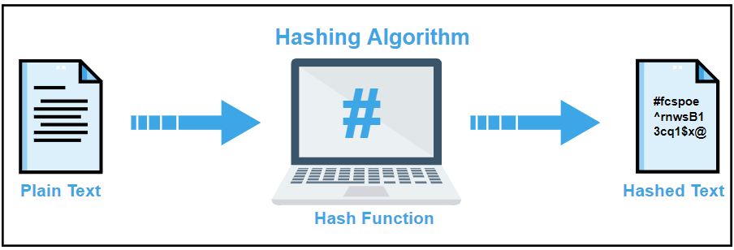

Slide 7
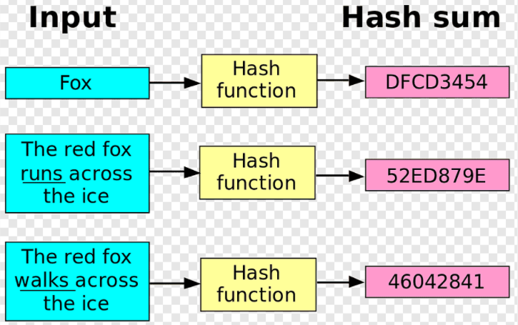

Slide 8
Hashing V.S. Encryption
Hello, world.
A sample sentence to show encryption.
k
E
NhbXBsZSBzZW50ZW5jZSB0byBzaG93IEVuY3J5cHRpb24KsZSBzZ
Hello, world.
A sample sentence to show encryption.
D
k
NhbXBsZSBzZW50ZW5jZSB0byBzaG93IEVuY3J5cHRpb24KsZSBzZ
Encryption is two way, and requires a key to encrypt/decrypt
This is a clear text that can easily read without using the key. The sentence is longer than the text above.
h
52f21cf7c7034a20 17a21e17e061a863
Hashing is one-way. There is no 'de-hashing’

Slide 9
A hash function H accepts a variable-length block of data M as input and produces a fixed-size hash value h = H(M).
A "good" hash function has the property that the results of applying the function to a large set of inputs will produce outputs that are evenly distributed, and apparently random.
In general terms, the principal object of a hash function is data integrity. A change to any bit or bits in M results, with high probability, in a change to the hash code.

Slide 10
Cryptographic hash function
The kind of hash function needed for security applications is referred to as a cryptographic hash function.
A cryptographic hash function is an algorithm for which it is computationally infeasible (because no attack is significantly more efficient than brute force) to find either
a data object that maps to a pre-specified hash result (the one-way property) or
two data objects that map to the same hash result (the collision-free property).
Because of these characteristics, hash functions are often used to determine whether or not data has changed

Slide 11
Hash Function Applications
Message Authentication
Digital Signatures
One way Password File
Intrusion Detection and Prevention

Slide 12
Message Authentication
Message authentication is a mechanism or service used to verify the integrity of a message.
Message Authentication assures that data received are exactly as sent without any modification.
When a hash function is used for message authentication, that hash function value is referred as message digest.

Slide 13
Password Verification
Store Hashing Password
Verification an input password against the stored hash
Iam#4VKU
Iam#4VKU
Password store
h
h
661dce0da2bcb2d8 2884e0162acf8194
661dce0da2bcb2d8 2884e0162acf8194
661dce0da2bcb2d8 2884e0162acf8194
Hash Matching Exactly?
Password store
Yes
No
Grant
Deny

Slide 14
Md5 algorithm
The MD5 (message-digest algorithm) hashing algorithm is a one-way cryptographic function that accepts a message of any length as input and returns as output a fixed-length digest value to be used for authenticating the original message.
The MD5 hash function was originally designed for use as a secure cryptographic hash algorithm for authenticating digital signatures. But MD5 has been deprecated for uses other than as a noncryptographic checksum to verify data integrity and detect unintentional data corruption.

Slide 15
MD5 used for….
Although originally designed as a cryptographic message authentication code algorithm for use on the internet, MD5 hashing is no longer considered reliable for use as a cryptographic checksum because security experts have demonstrated techniques capable of easily producing MD5 collisions on commercial off-the-shelf computers. An encryption collision means two files have the same hash. Hash functions are used for message security, password security, computer forensics and cryptocurrency.
The algorithm takes as input a message of arbitrary length and produces as output a 128-bit 'fingerprint' or 'message digest' of the input. It is conjectured that it is computationally infeasible to produce two messages having the same message digest, or to produce any message having a given prespecified target message digest. The MD5 algorithm is intended for digital signature applications, where a large file must be 'compressed' in a secure manner before being encrypted with a private (secret) key under a public-key cryptosystem such as RSA.

Slide 16
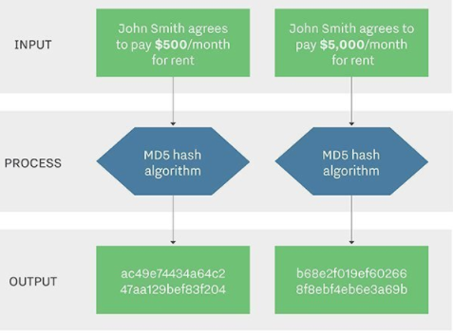

Slide 17
Md5 Characteristics
Message digests, also known as hash functions, are one-way functions; they accept a message of any size as input and produce as output a fixed-length message digest.
MD5 is the third message-digest algorithm Rivest created. MD2, MD4 and MD5 have similar structures, but MD2 was optimized for 8-bit machines, in comparison with the two later algorithms, which are designed for 32-bit machines.
The MD5 algorithm is an extension of MD4, which the critical review found to be fast but potentially insecure. In comparison, MD5 is not quite as fast as the MD4 algorithm, but offered much more assurance of data security.

Slide 18
How Md5 works?
The MD5 message-digest hashing algorithm processes data in 512-bit strings, broken down into 16 words composed of 32 bits each. The output from MD5 is a 128-bit message-digest value.
Computation of the MD5 digest value is performed in separate stages that process each 512-bit block of data along with the value computed in the preceding stage. The first stage begins with the message-digest values initialized using consecutive hexadecimal numerical values. Each stage includes four message-digest passes, which manipulate values in the current data block and values processed from the previous block. The final value computed from the last block becomes the MD5 digest for that block.

Slide 19
Disadvantages of Md5
A major concern with MD5 is the potential it has for message collisions when message hash codes are inadvertently duplicated.
MD5 hash code strings also are limited to 128 bits.
This makes them easier to breach than other hash code algorithms that followed.

Slide 20
SHA
Securing Hash Algorithm

Slide 21
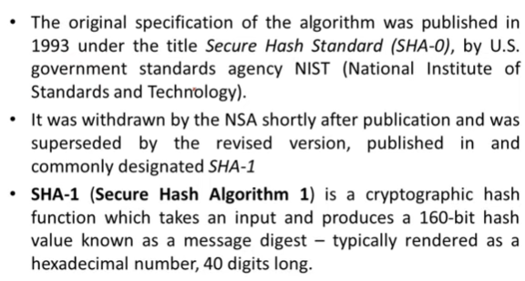
Introduction to SHA

Slide 22
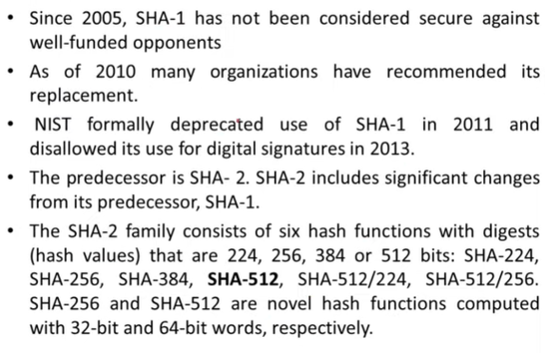

Slide 23
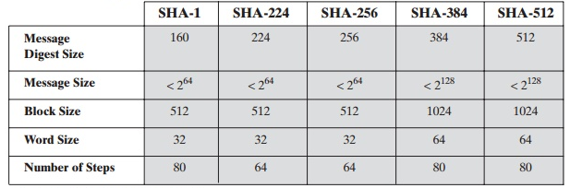
SHA 512 Algorithm
The algorithm takes as input a message with a maximum length of less than 2¹²⁸ bits and produces as output a 512-bit message digest.
The input is processed in 1024-bit blocks
SHA-512, or Secure Hash Algorithm 512, is a hashing algorithm used to convert text of any length into a fixed-size string. Each output produces a SHA-512 length of 512 bits (64 bytes).
This algorithm is commonly used for email addresses hashing, password hashing, and digital record verification. SHA-512 is also used in blockchain technology,

Slide 24
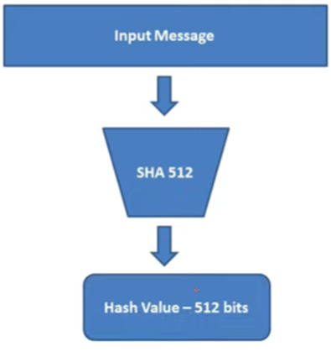
SHA-512

Slide 25
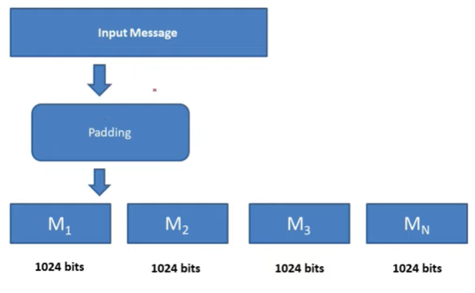

Slide 28
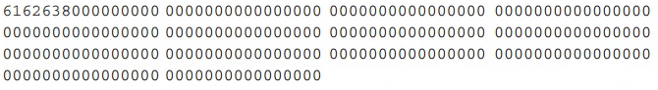

Slide 31
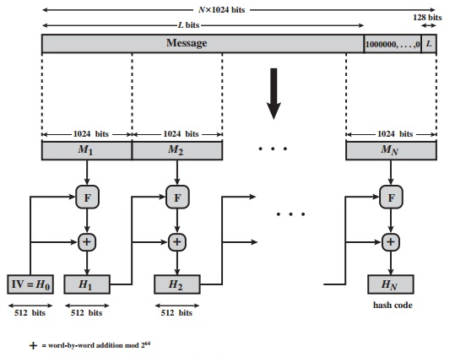
Message Digest Generation using SHA-512

Slide 32
Message Authentication (MAC)

Slide 33
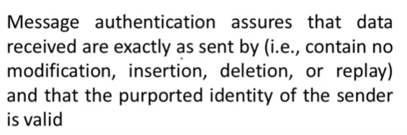
Message Authentication
Two things we have to check.
Whether the message has been altered .
Whether the message is send by the legitimate sender.

Slide 34
Message Authentication
Message Encryption
Hash function
Message Authentication code (MAC)
Message authentication code (MAC) is an authentic technique involves the use of a secret key to generate a small fixed size block of data.
MAC is not a digital signature.

Slide 35
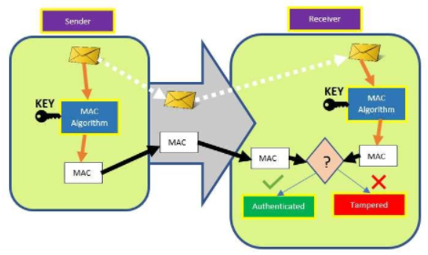
MAC

Slide 36
Hash based MAC (HMAC)
The idea of using a hash function to generate a MAC is relatively new.
HMAC or hash-based message authentication code was first defined and published in 1996 and is now used for IP security and SSL.
The advantage of using a hash-based MAC as opposed to a MAC based a block cipher is speed.
Hash functions like MD5 and SHA are generally faster in software than symmetric block ciphers like AES and DES.

Slide 37
objectives
As the Hash Function, HMAC is also aimed to be one way, i.e, easy to generate output from input but complex the other way round.
It aims at being less affected by collisions than the hash functions.
HMAC reuses the algorithms like MD5 and SHA-1 and checks to replace the embedded hash functions with more secure hash functions, in case found.
HMAC tries to handle the Keys in a more simple manner.

Slide 38
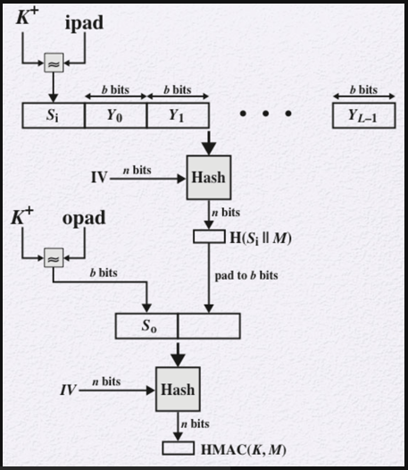
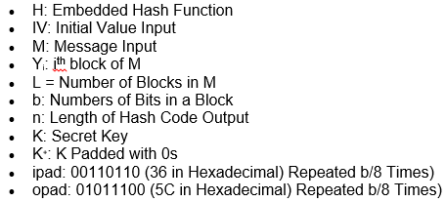

Slide 39
The HMAC structure follows these steps:
Append 0s to the left of K to create a b-bit string K⁺.
XOR K⁺ with ipad to produce the b-bit block S_{i}.
Append M to S_{i}.
Apply H to the stream generated in the previous step.
XOR K⁺ with opad to produce the b-bit block S₀.
Append the hash result from step 4 to S₀.
Apply H to the stream generated in step 6 and output the result

Slide 40
Digital Signature
A digital signature is a mathematical technique used to validate the authenticity and integrity of a message, software, or digital document.

Slide 41
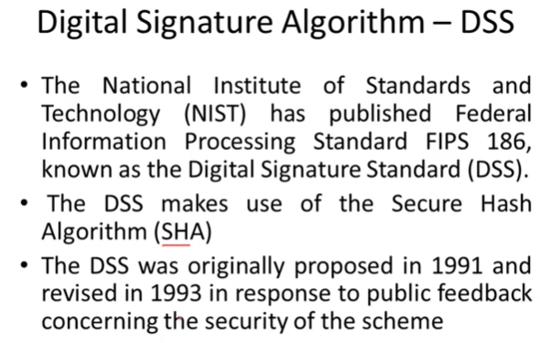

Slide 42
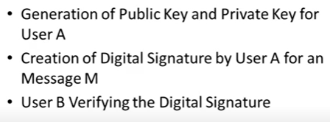
Digital Signature Standard (DSS)

Slide 43
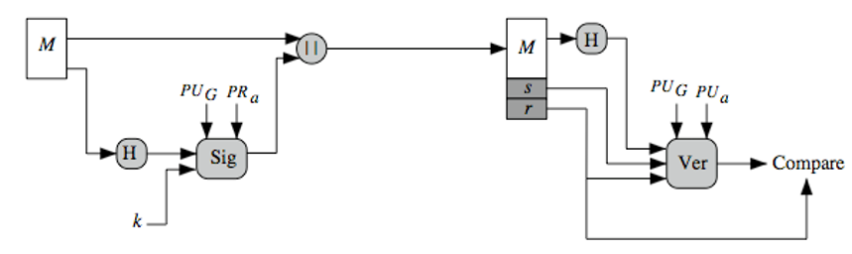
Digital Signature Standard (DSS)

Slide 44
